Slide 1
HB Field Mapping
Steven Lassiter
Eric Sun
Mike Fowler

Slide 2
Index
Mapping setup
Bore central line map
Stray field map @ 1200A
Stray field map @ 4000A
Coil movement
Off midplane stray field Maps @3500A
Integral stray field along exit beam line & Tosca yoke modifications.

Slide 3
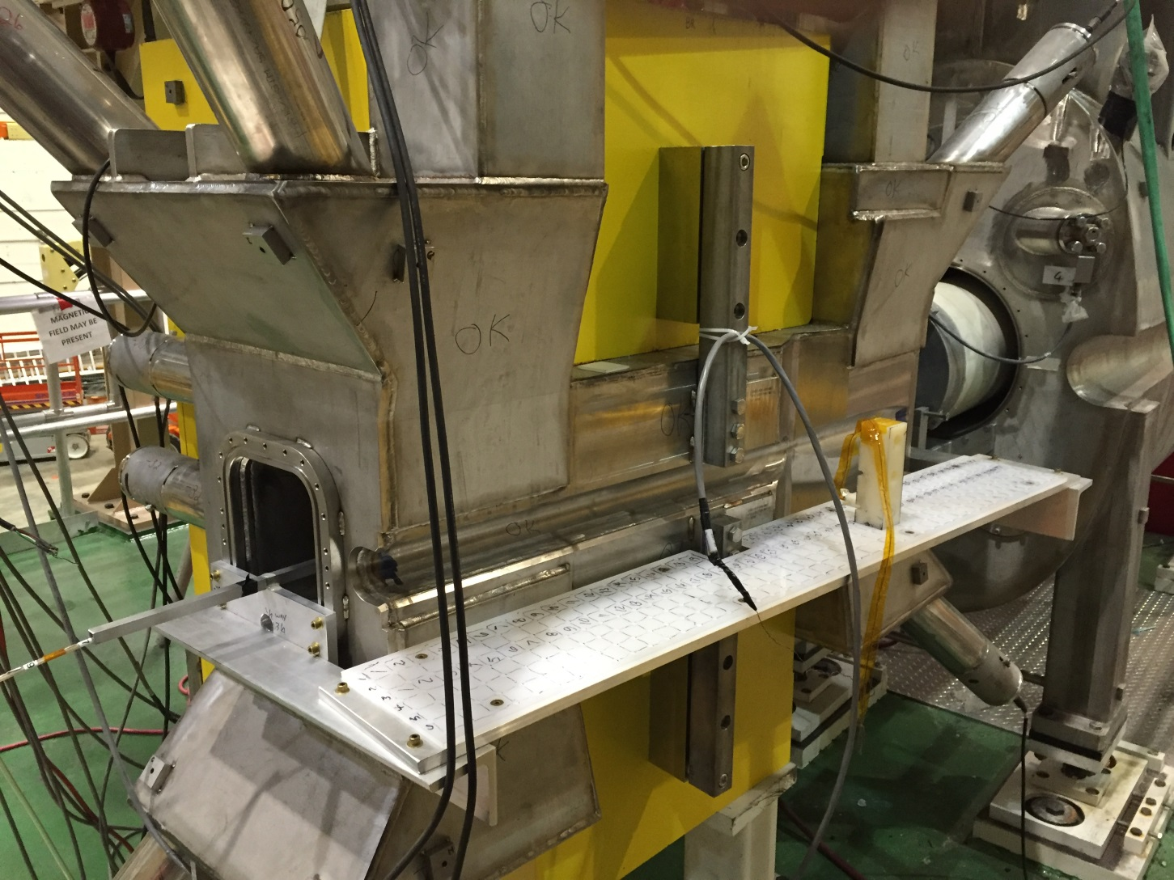
HB Stray Field Mapping Setup
Stray field mapping table and probe holder
Central field tube

Slide 4
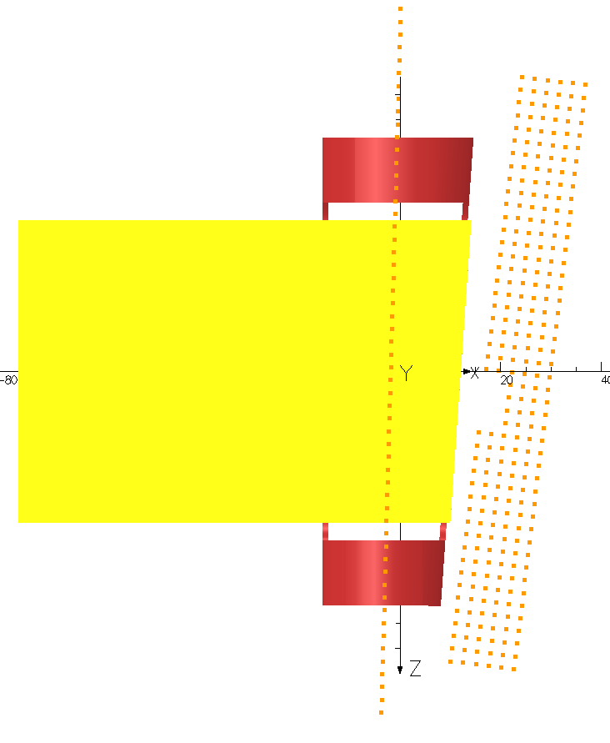
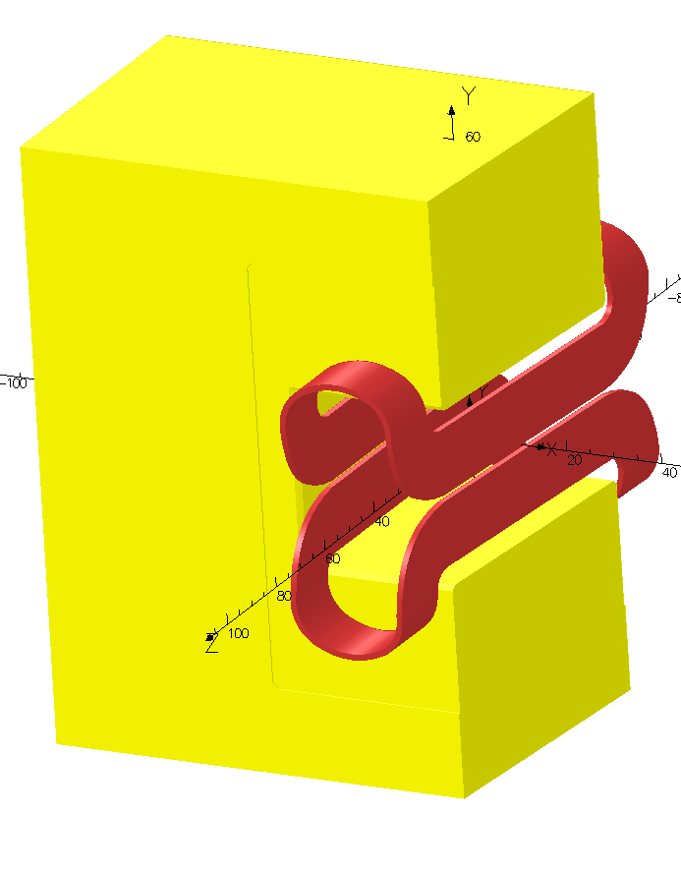
HB Magnet - Yoke & Coil
Point #27 is used as midpoint

Slide 5
Notes
Lakeshore Hall probes used to measure the By field (vertical component).
Stray field Hall probe alignment of ~1mm. (surveyed positions, hand aligned probe).
Central field Hall probe alignment of the order 3mm in Z. (Tape measure).
Spacing between measured points is 1”.
Fields not corrected for current variations. Current was very stable throughout.
Field mapping table is not perfectly aligned to midplane axis of magnet.

Slide 6
HB Central Field vs Tosca
Point #27 | Measured | Tosca @ point | Difference | Error %
Current | By [kG] | By [kG] | Gauss
1200 | 8.079 | 8.010 | 69.3 | 0.86
2000 | 13.416 | 13.342 | 73.9 | 0.55
3000 | 19.907 | 19.879 | 27.6 | 0.14
3500 | 22.932 | 22.933 | -0.9 | 0.00
4000 | 25.695 | 25.771 | -75.6 | -0.29

Slide 13


Stray Field map vs Beam line @ 5.5° Row 1 nearly coincides with 5.5° beam line

Slide 14
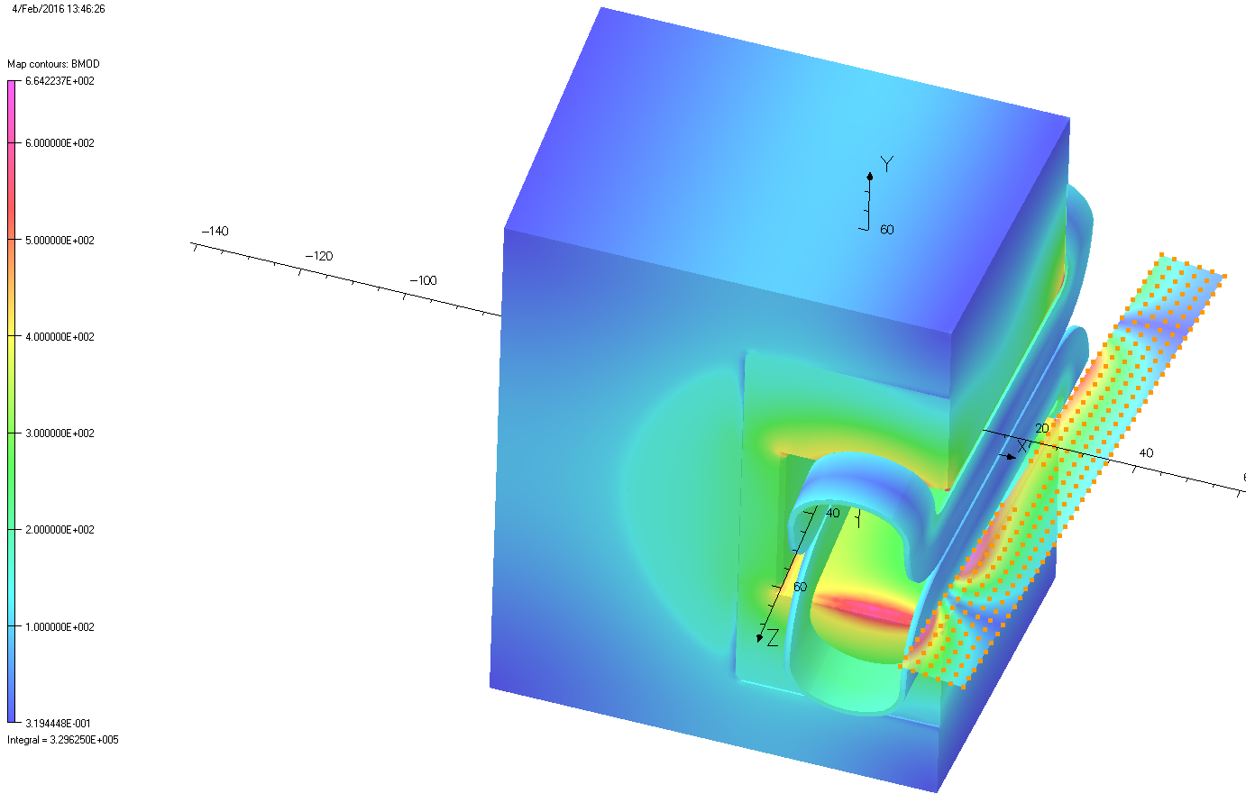
Tosca Field Map @ 1,200A

Slide 15
Stray By Fields at 1,200A

Slide 16
Row 1 @ 1,200A
Sum of Errors = 20.0%

Slide 17
Row 2 @ 1,200A
Sum of Errors = 15.3%

Slide 18
Row 3 @ 1,200A
Sum of Errors = 9.5%

Slide 19
Row 4 @ 1,200A
Sum of Errors = 9.0%

Slide 20
Row 5 @ 1,200A
Sum of Errors = 8.8%

Slide 21
Row 6 @ 1,200A
Sum of Errors = 9.4%

Slide 22
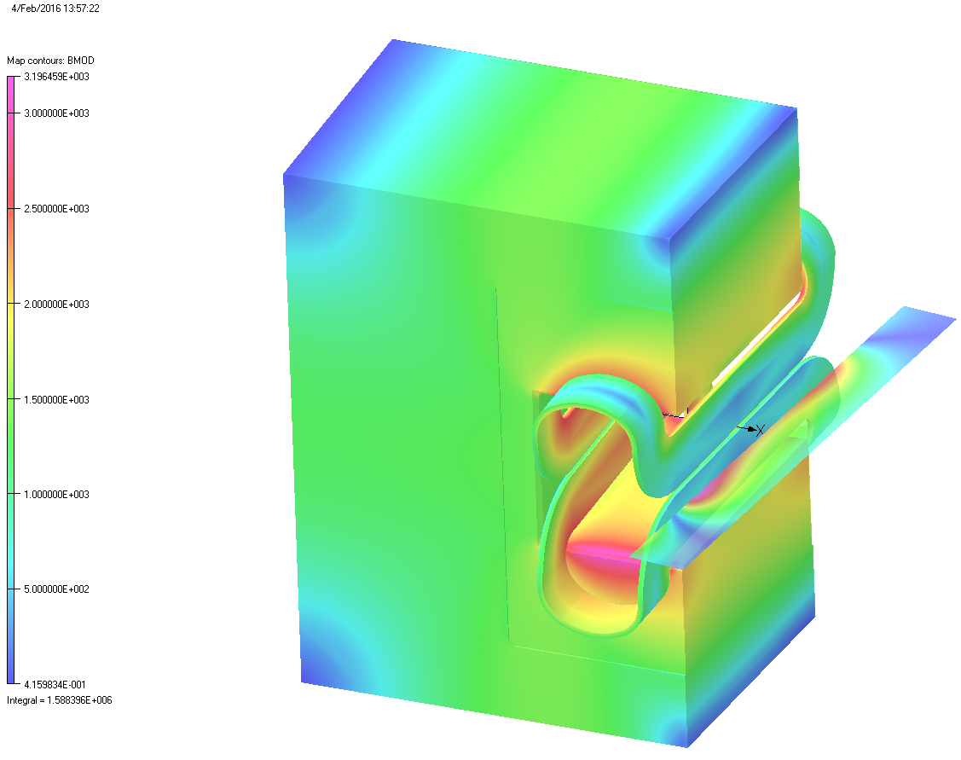
Tosca Field Map @ 4,000A

Slide 23
Stray By Fields at 4,000A

Slide 24
Row 1 @ 4,000A
Sum of Errors = 11.8%

Slide 25
Row 2 @ 4,000A
Sum of Errors = 13.5%

Slide 26
Row 3 @ 4,000A
Sum of Errors = 9.0%

Slide 27
Row 4 @ 4,000A
Sum of Errors = 8.5%

Slide 28
Row 5 @ 4,000A
Sum of Errors = 8.2%

Slide 29
Row 6 @ 4,000A
Sum of Errors = 8.5%

Slide 30
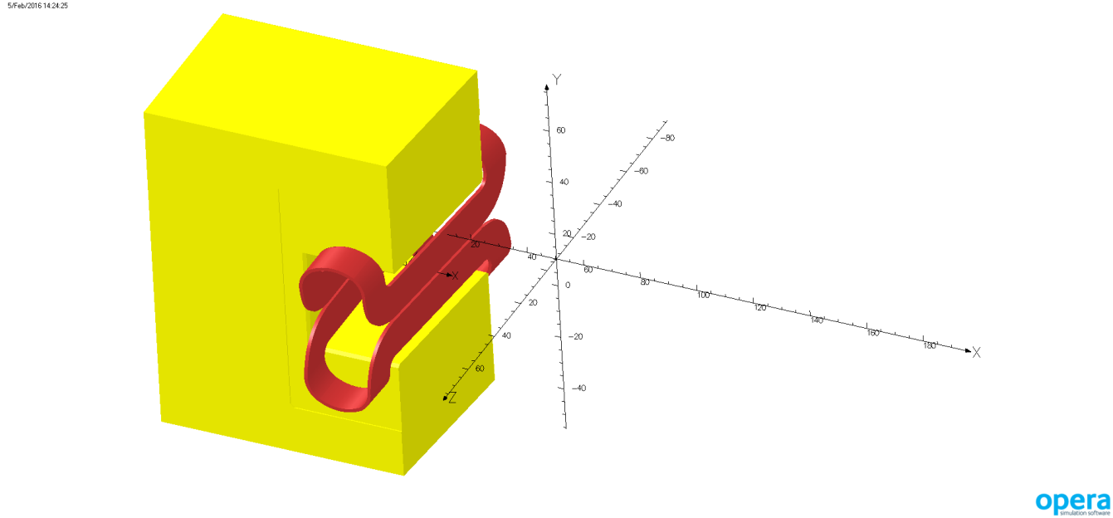
Coil translations in Tosca
Moved the coil in X direction -3 mm and +3mm.
A +3mm matched the measured data better at higher excitations.
X direction
- +

Slide 31
Row 1 @ 1,200A Coils moved +3 mm in X
Sum of Errors = 19.8%

Slide 32
Row 6 @ 1,200A Coils moved +3 mm in X
Sum of Errors = 1.7%

Slide 33
Row 1 @ 4,000A Coils moved +3 mm in X
Sum of Errors = 11.4%

Slide 34
Row 6 @ 4,000A Coils moved +3 mm in X
Sum of Errors = 3.3%

Slide 35
Observations
Model is sufficient to investigate stray field reductions options.
Improvements to match measurements to Model include:
More Tosca simulations on coil geometry.
Increasing coil end lengths, widths.
Try to add Q1 yoke to model.
Accurate probe survey.

Slide 36
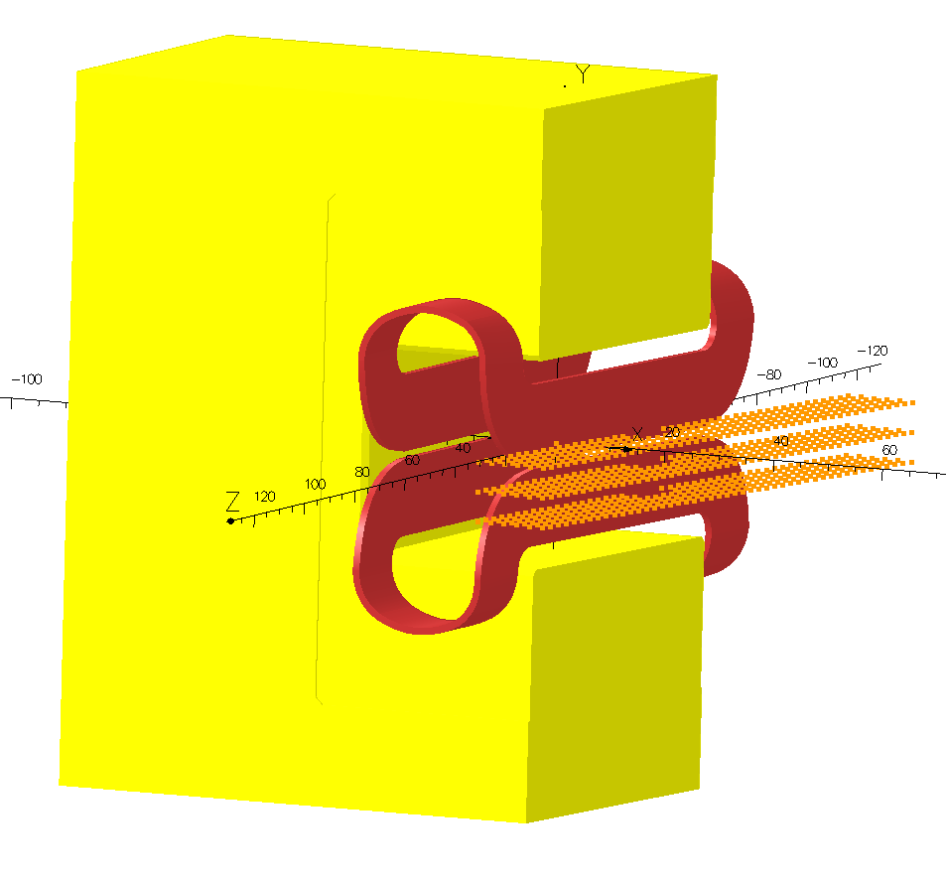
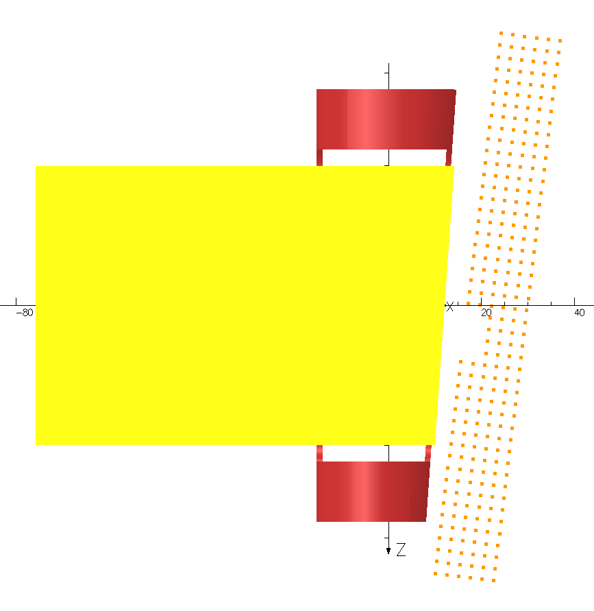
Stray Field Data Points Midplane and Off Midplane (+/- 50mm)

Slide 37
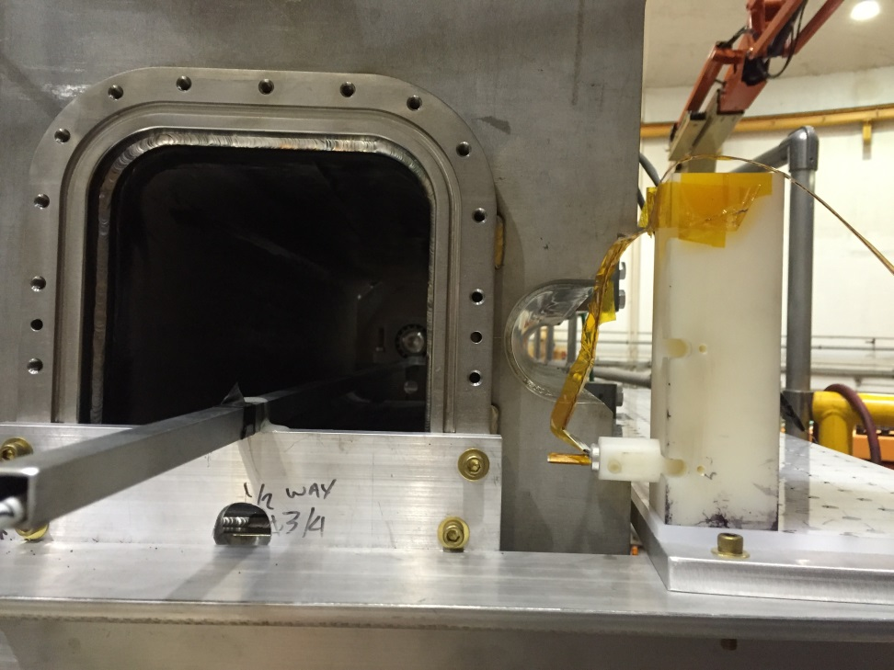
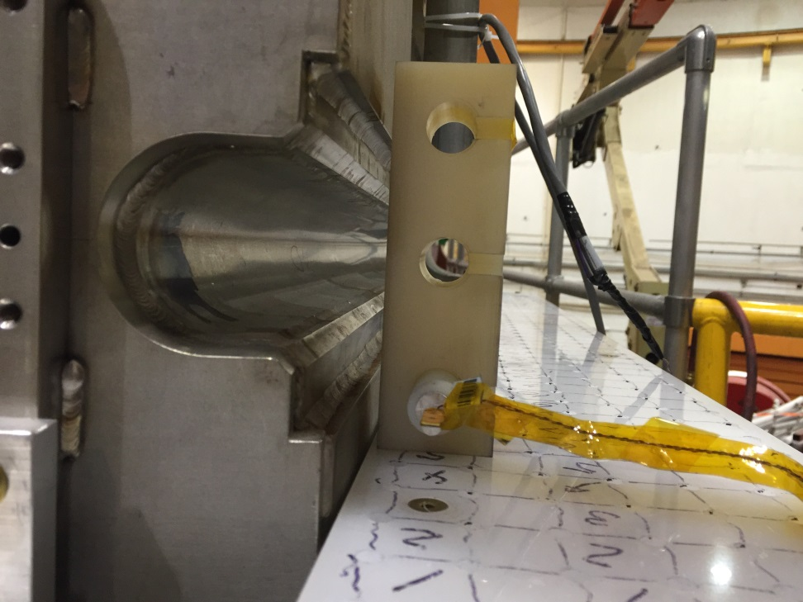
Below Mid-plane Setup
Probe is moved to lower hole
Probe holder is rotated about Vertical axis.

Slide 38
3500A Probe Rotated @ Midplane
Sum of Errors = 10.6%

Slide 39
3500A Probe rotated @ 50 mm below midplane

Slide 40
3500A Probe rotated @ 50 mm above midplane

Slide 41
3500A Midplane Symmetry
Good agreement between upper and lower measurements +/- 20 Gauss or less. No asymmetry noted.

Slide 42
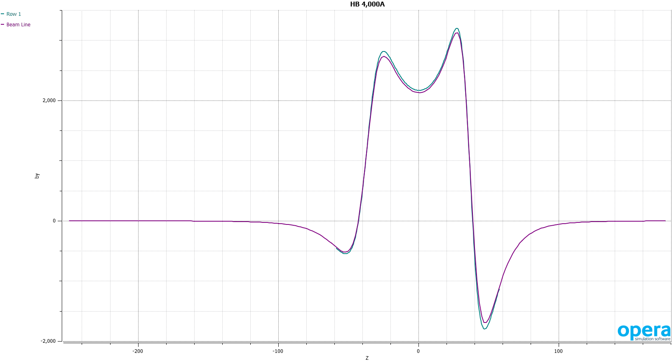
Integral Stray By Field along Beamline @ 5.5° from Tosca Model
Cyan = Row 1
Red = Beam Line
Row 1 of mapping table vs true 5.5° beamline
Tosca Model predicts an Integral By along beam line of 0.126 T.m at 4,000A
Criteria is 0.020T.m to prevent off beam dump window excursion.

Slide 43
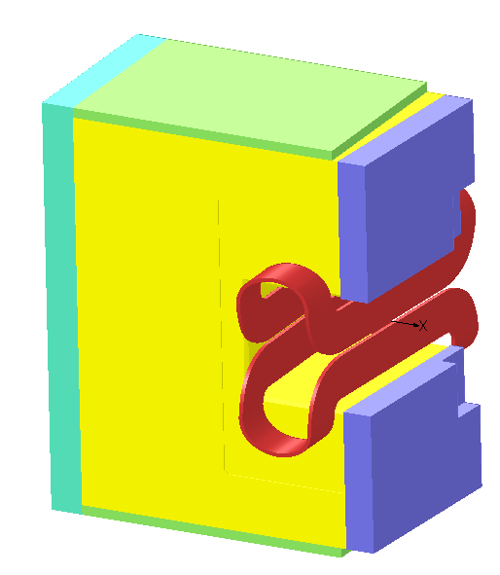
Tosca Model - Mods to Yoke
Additional Iron pieces were included in the Tosca model.
Shapes and sizes are based on what geometry will allow.
Top addition may be hardest to add.
Various yoke configurations, using a +3mm coil offset were modeled.

Slide 44
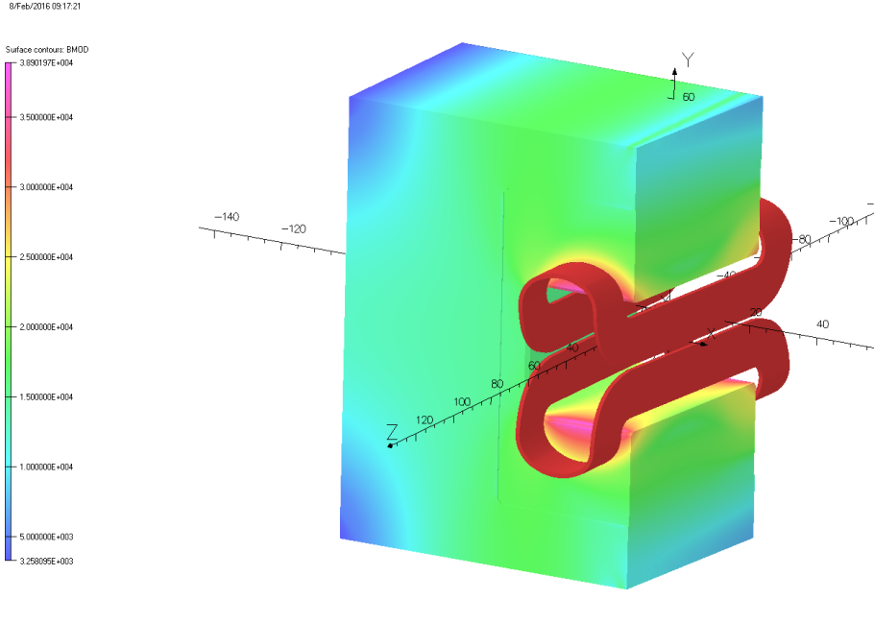
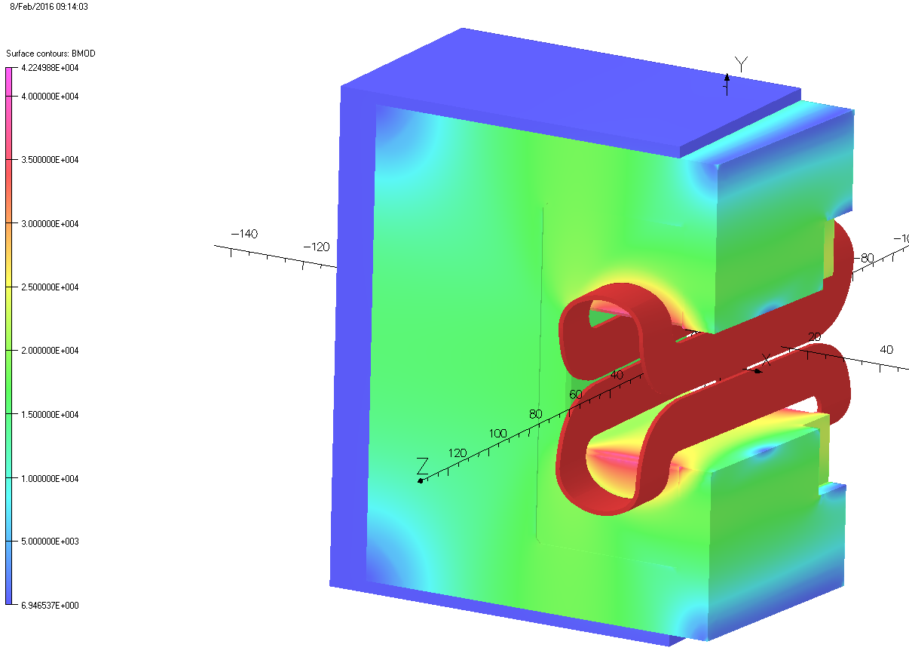
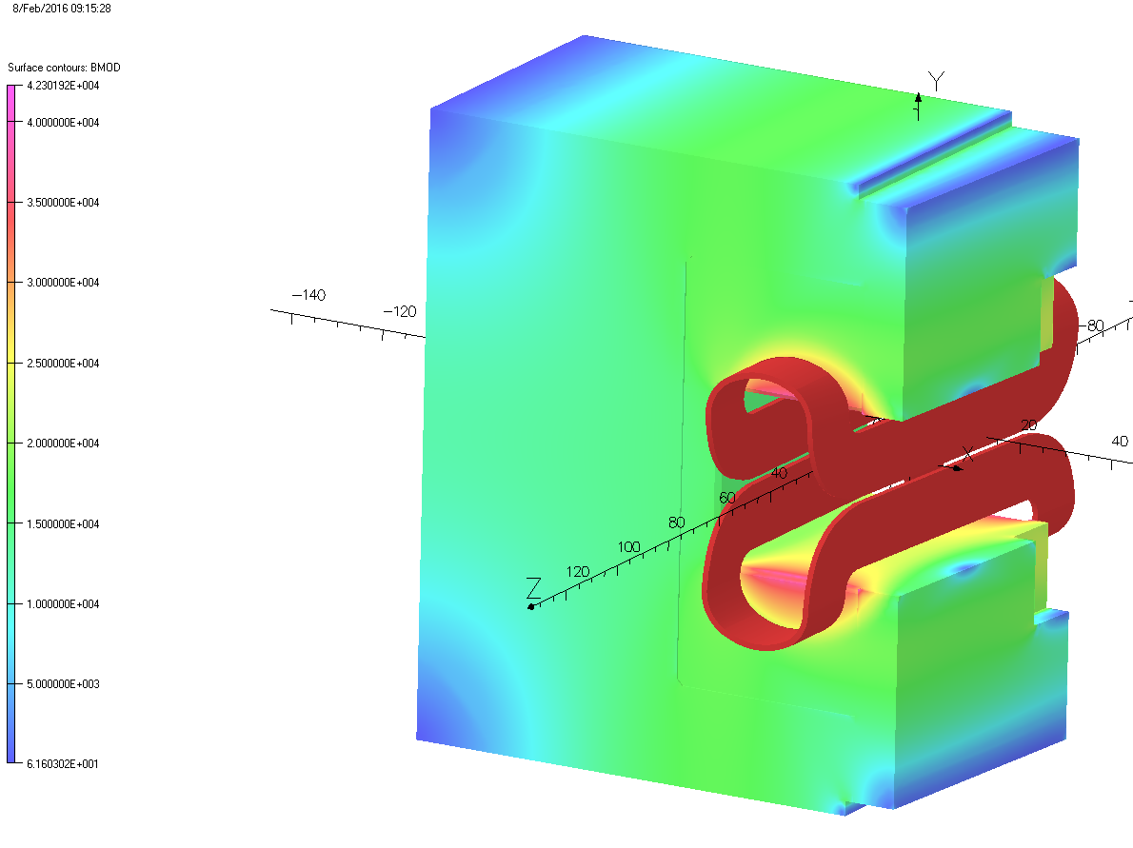
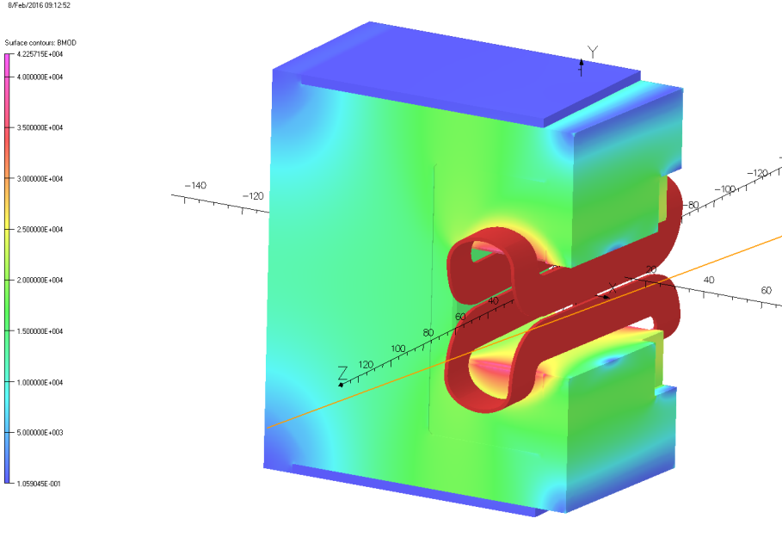
Adding Yoke Pieces to HB
As Built
Beam Line
All Pieces
Beam Line and Back Side

Slide 45
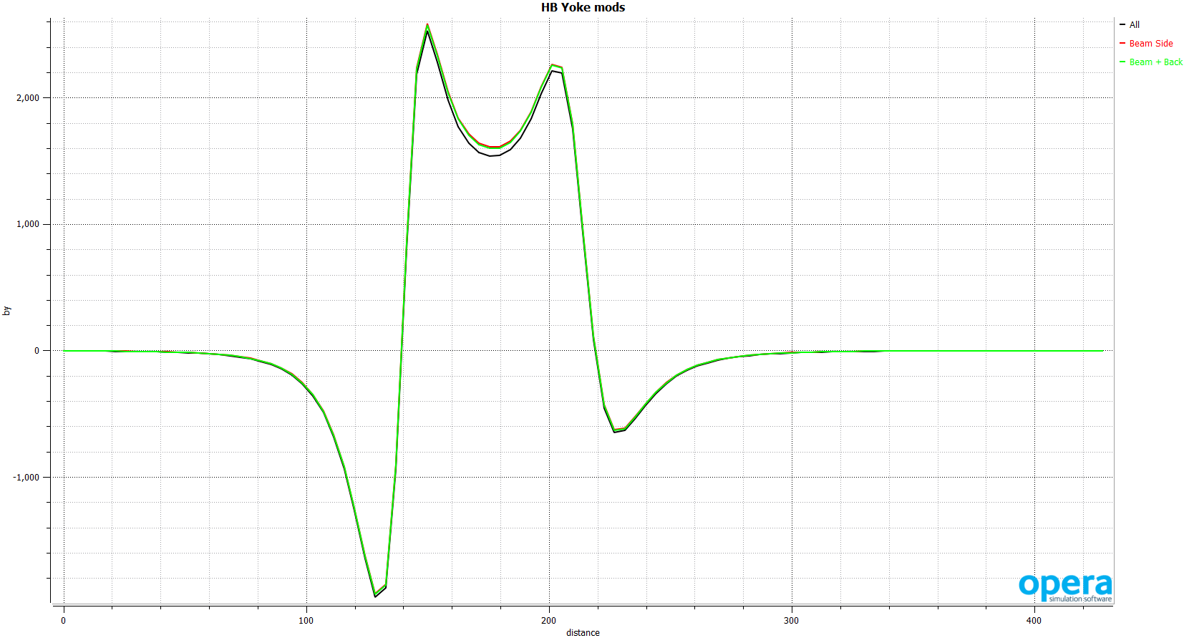
Stray Field Along Beam Axis
All = 0.0705 T.m
Beam Side Only = 0.0772 T.m
Beam + Back Side = 0.0761 T.m
As Built = 0.1260 T.m
(see Slide 3)

Slide 46
Conclusion
Tosca Model vs Measurement agreement is better than 1% inside the bore over the whole excitation range. Stray field predictions agree to within a few percent along the yoke. Larger errors at the front and back of the magnet (coil ends).
Errors in modeling the stray field are possible due to matching the as built coil end geometry and not modeling Q1’s Yoke.
Moving the coils +3mm in X improved the agreement between Tosca and measured data along the yoke region at higher excitation. At lower currents, moving the coils +3mm in X lowered the agreement, suggesting that there is a coil motion during excitation.
No asymmetry was observed in the off midplane measurements.
Additional Yoke pieces on beam side face will reduce the stray field by 39%. A factor of 4 reduction in stray field is still needed.

Slide 47
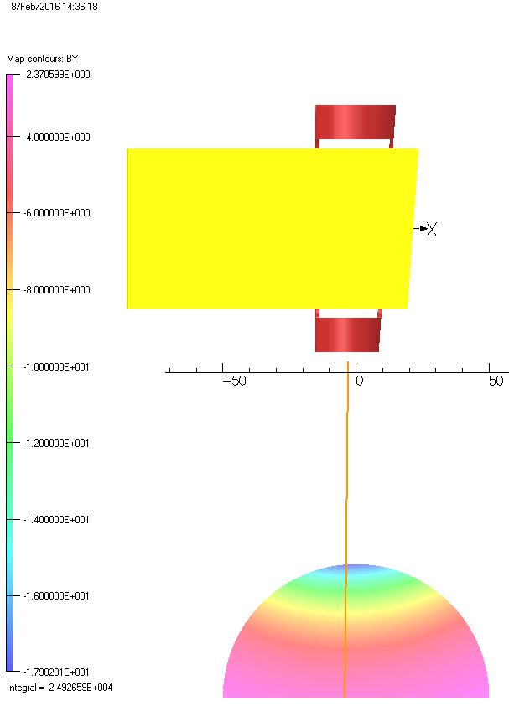
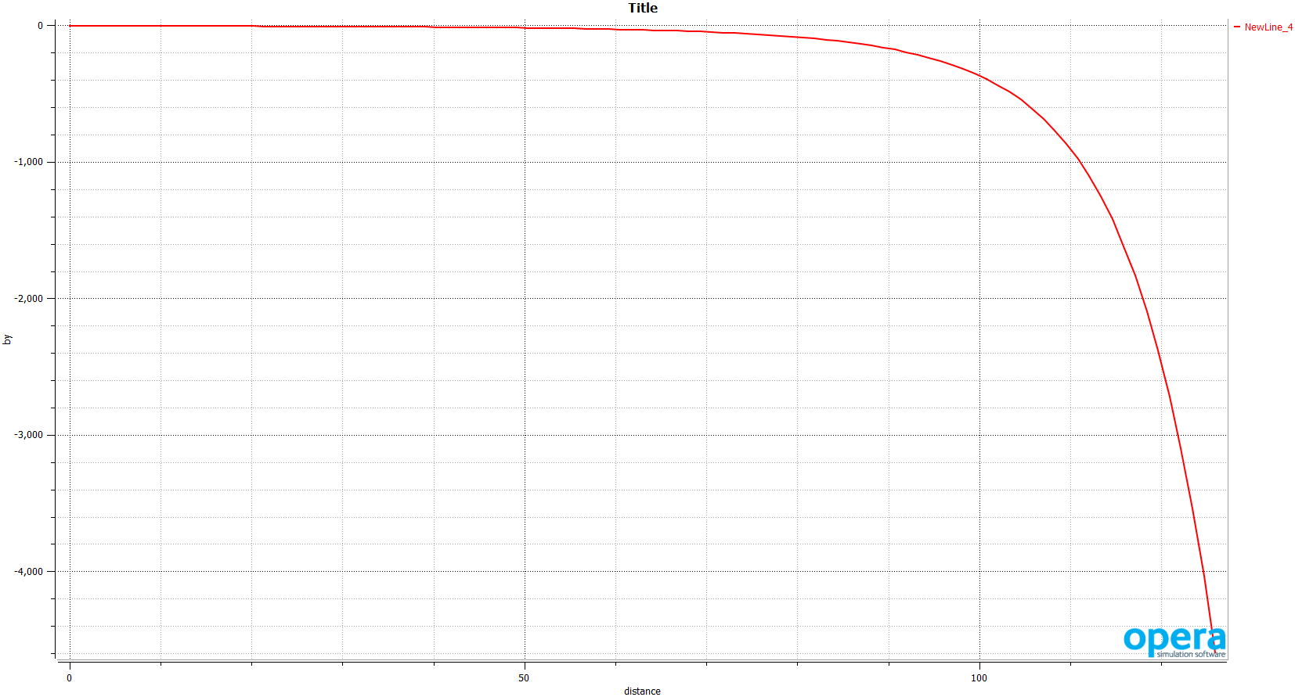
HB @ 4000A - Target

